Slide 1


- - The Book Store
Introduction about our website

Slide 2
About Us
Le Hong Hai - 1901040069
Pham Quang Ha - 1901040067
Dinh Quang Tung - 1901040192
Ha Thi Thanh Thao - 1801040206
We are group 4. We built a book store in Wordpress – Woocommerce platform.

Slide 3

Section Divider
This is interface of our website. It is The header of the website

Slide 4
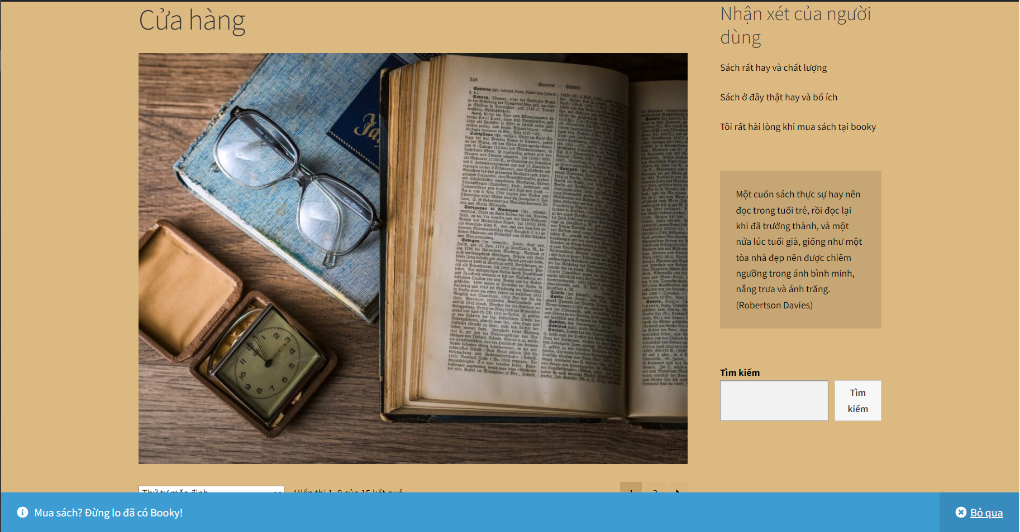
Section Divider
It is the body of the website

Slide 5
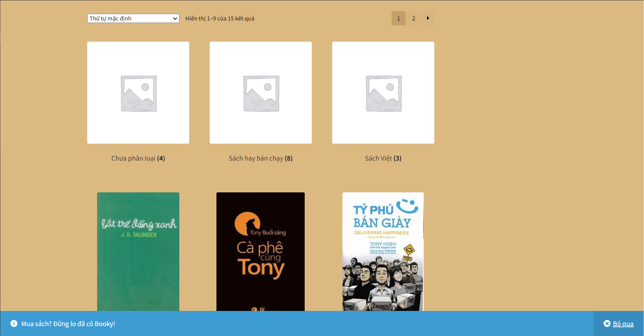
Section Divider
It is the body of the website

Slide 6

Section Divider
It is the body of the website

Slide 7
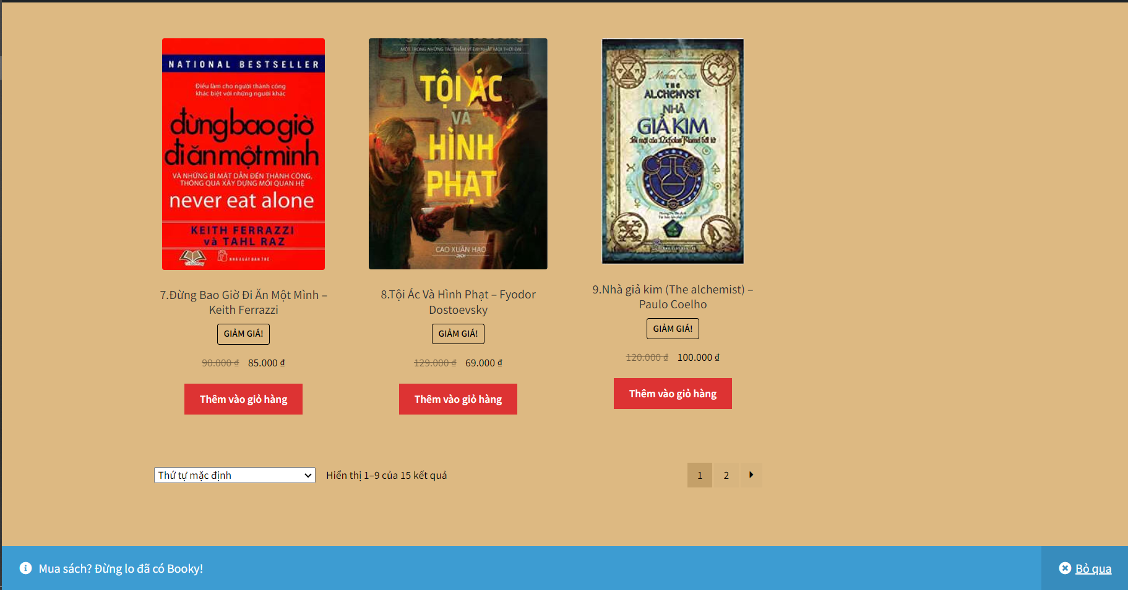
Section Divider
It is the body of the website

Slide 8
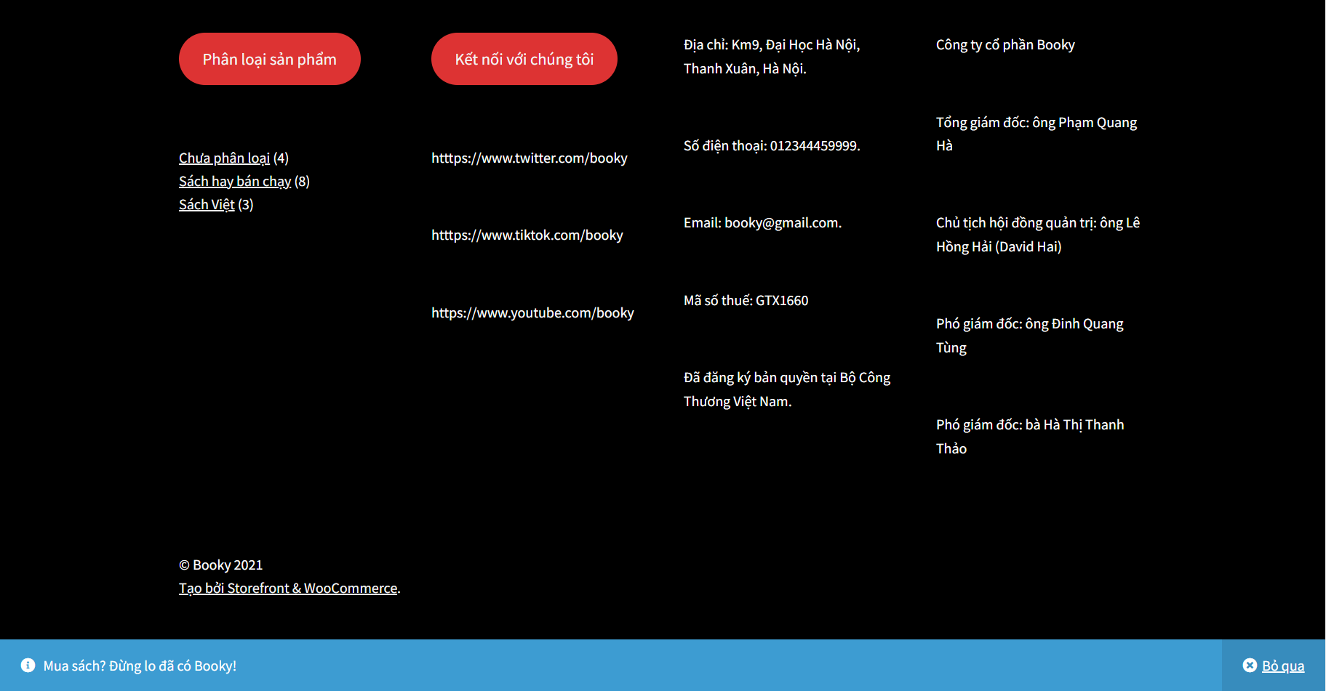
Section Divider
It is the footer of the website

Slide 9
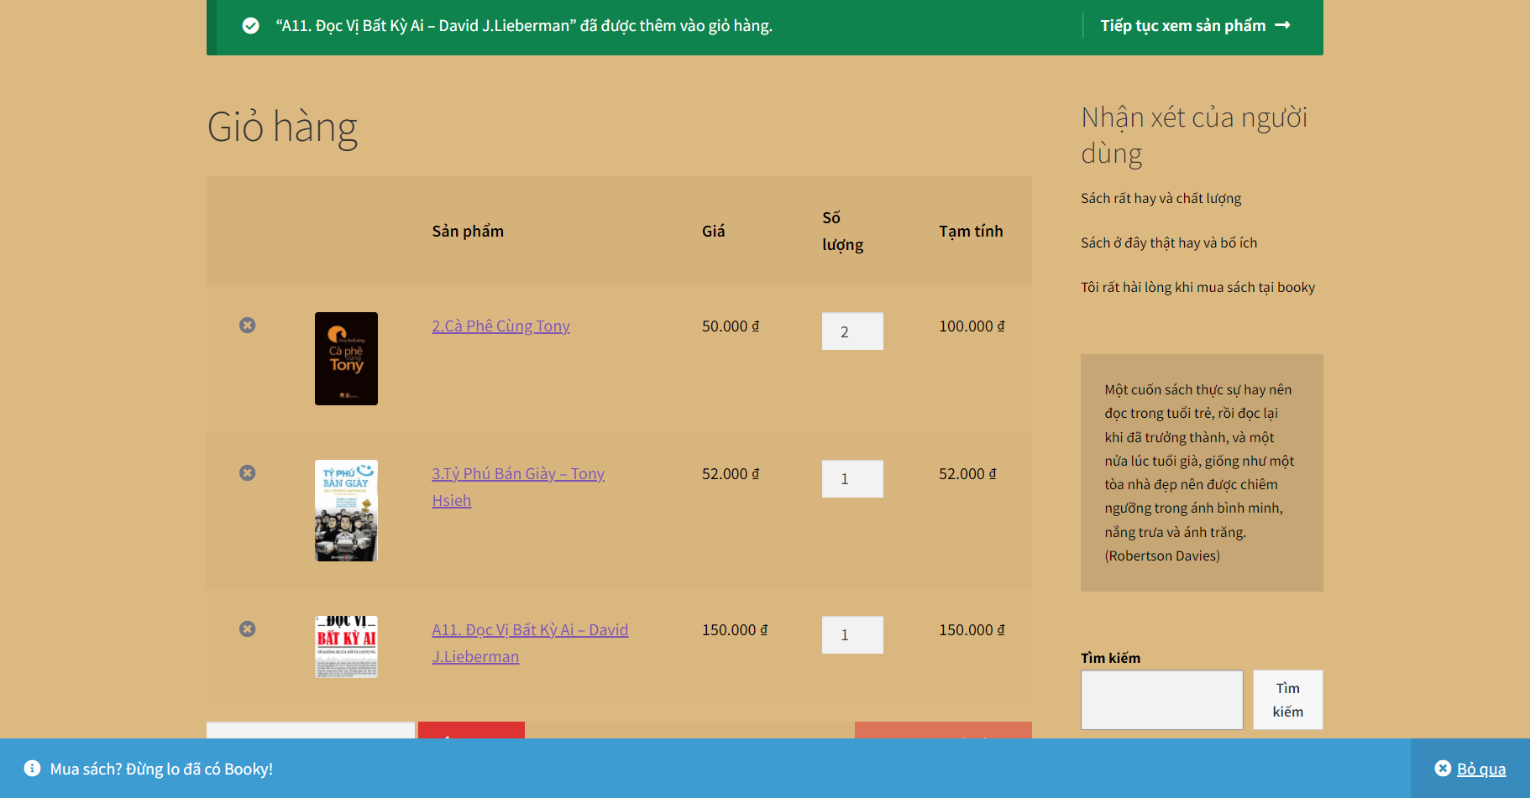
Section Divider
It is the Cart when buying products

Slide 10
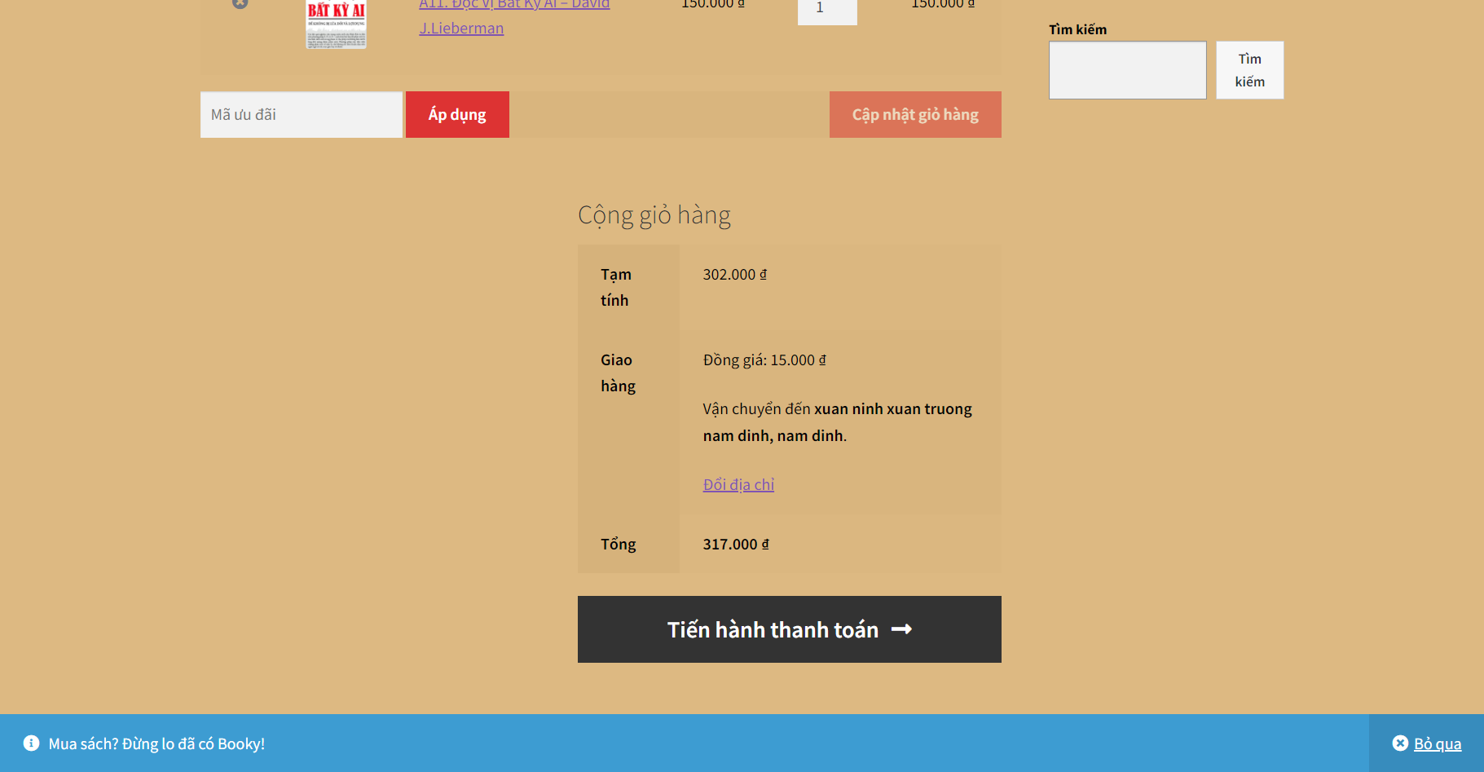
Section Divider
It is the payment processing

Slide 11
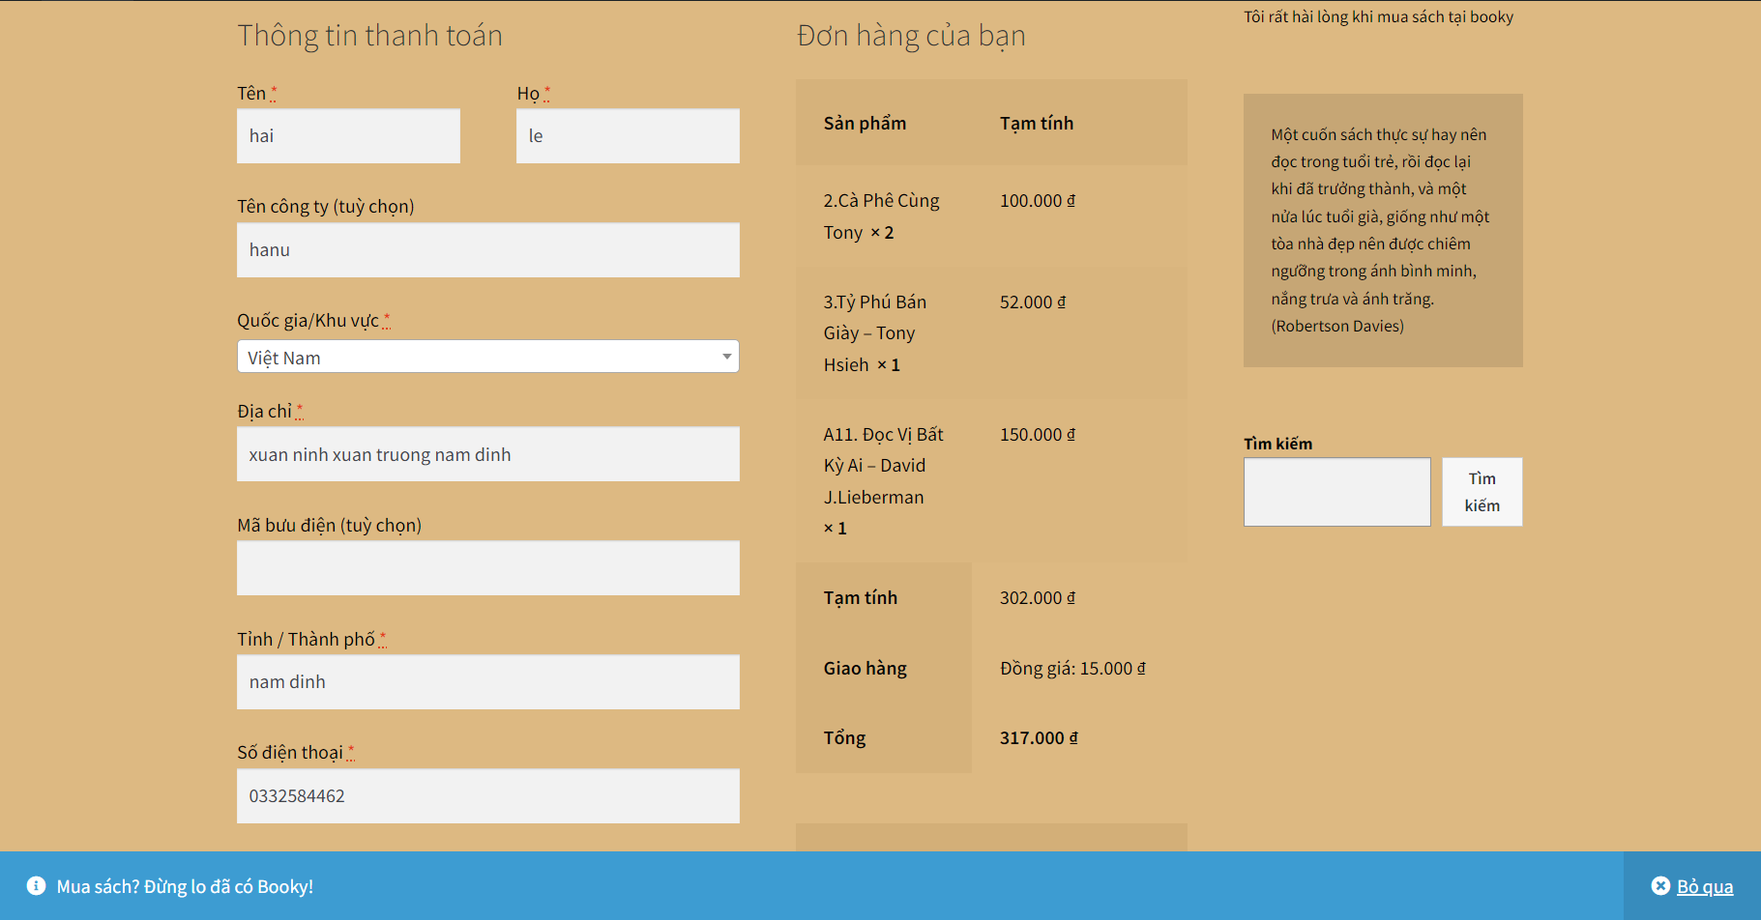
Section Divider
It is the book-ordering processing

Slide 12
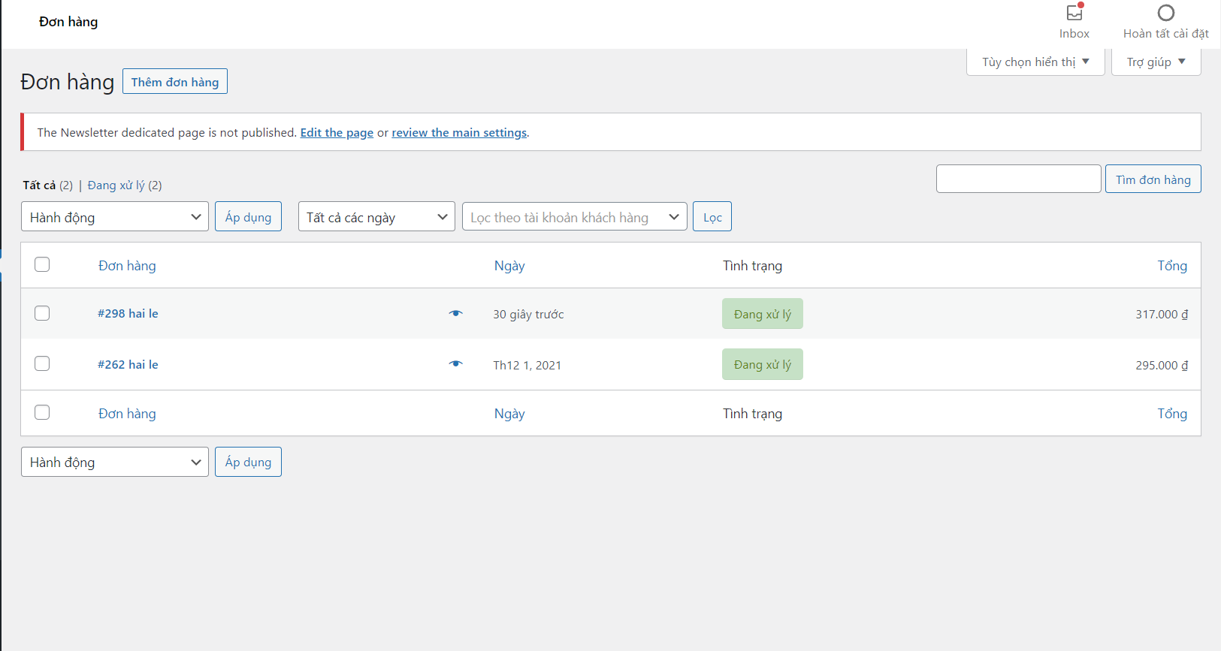
Section Divider
They are orders from customer

Slide 13
Summary
We built this website for book selling in ecommerce platform (wordpress & woocommerce). The mission & vision is to sell fanstatic books and give the best services for our customers.
Anyone can access the huge book resources of ours and having good knowledge!
Mission and Vision

Slide 14





Thank You
Booky Company
0123456789
booky@gmail.com
www.booky.ipcoms.vn

